Slide 1
Hello everyone!

Slide 2
Doctor appointment booking system
Python full stack development
Under the guidance of
Geetha Singh

Slide 3
Our team
2110030019- I N Chiranjeevi
2110030110- J Laasya Kruthi
2110030041- K Shikha
2110030100- E Srivardhan Reddy

Slide 4
Content table
Abstract
GitHub Setup
Work allocation by the team members
Data set collection
Tool setup

Slide 5
Abstract
In the healthcare service, we propose appointment scheduling problems and various applications and solution approaches in healthcare systems.
The problems are based on the flow of patients, patient preferences, and random arrival time and service.
What we plan to do is to provide the user with a solution to the problem they are facing. It has always fascinated me to imagine that we can get almost everything online then why can’t we get some trusted medical help using the same technology?

Slide 6
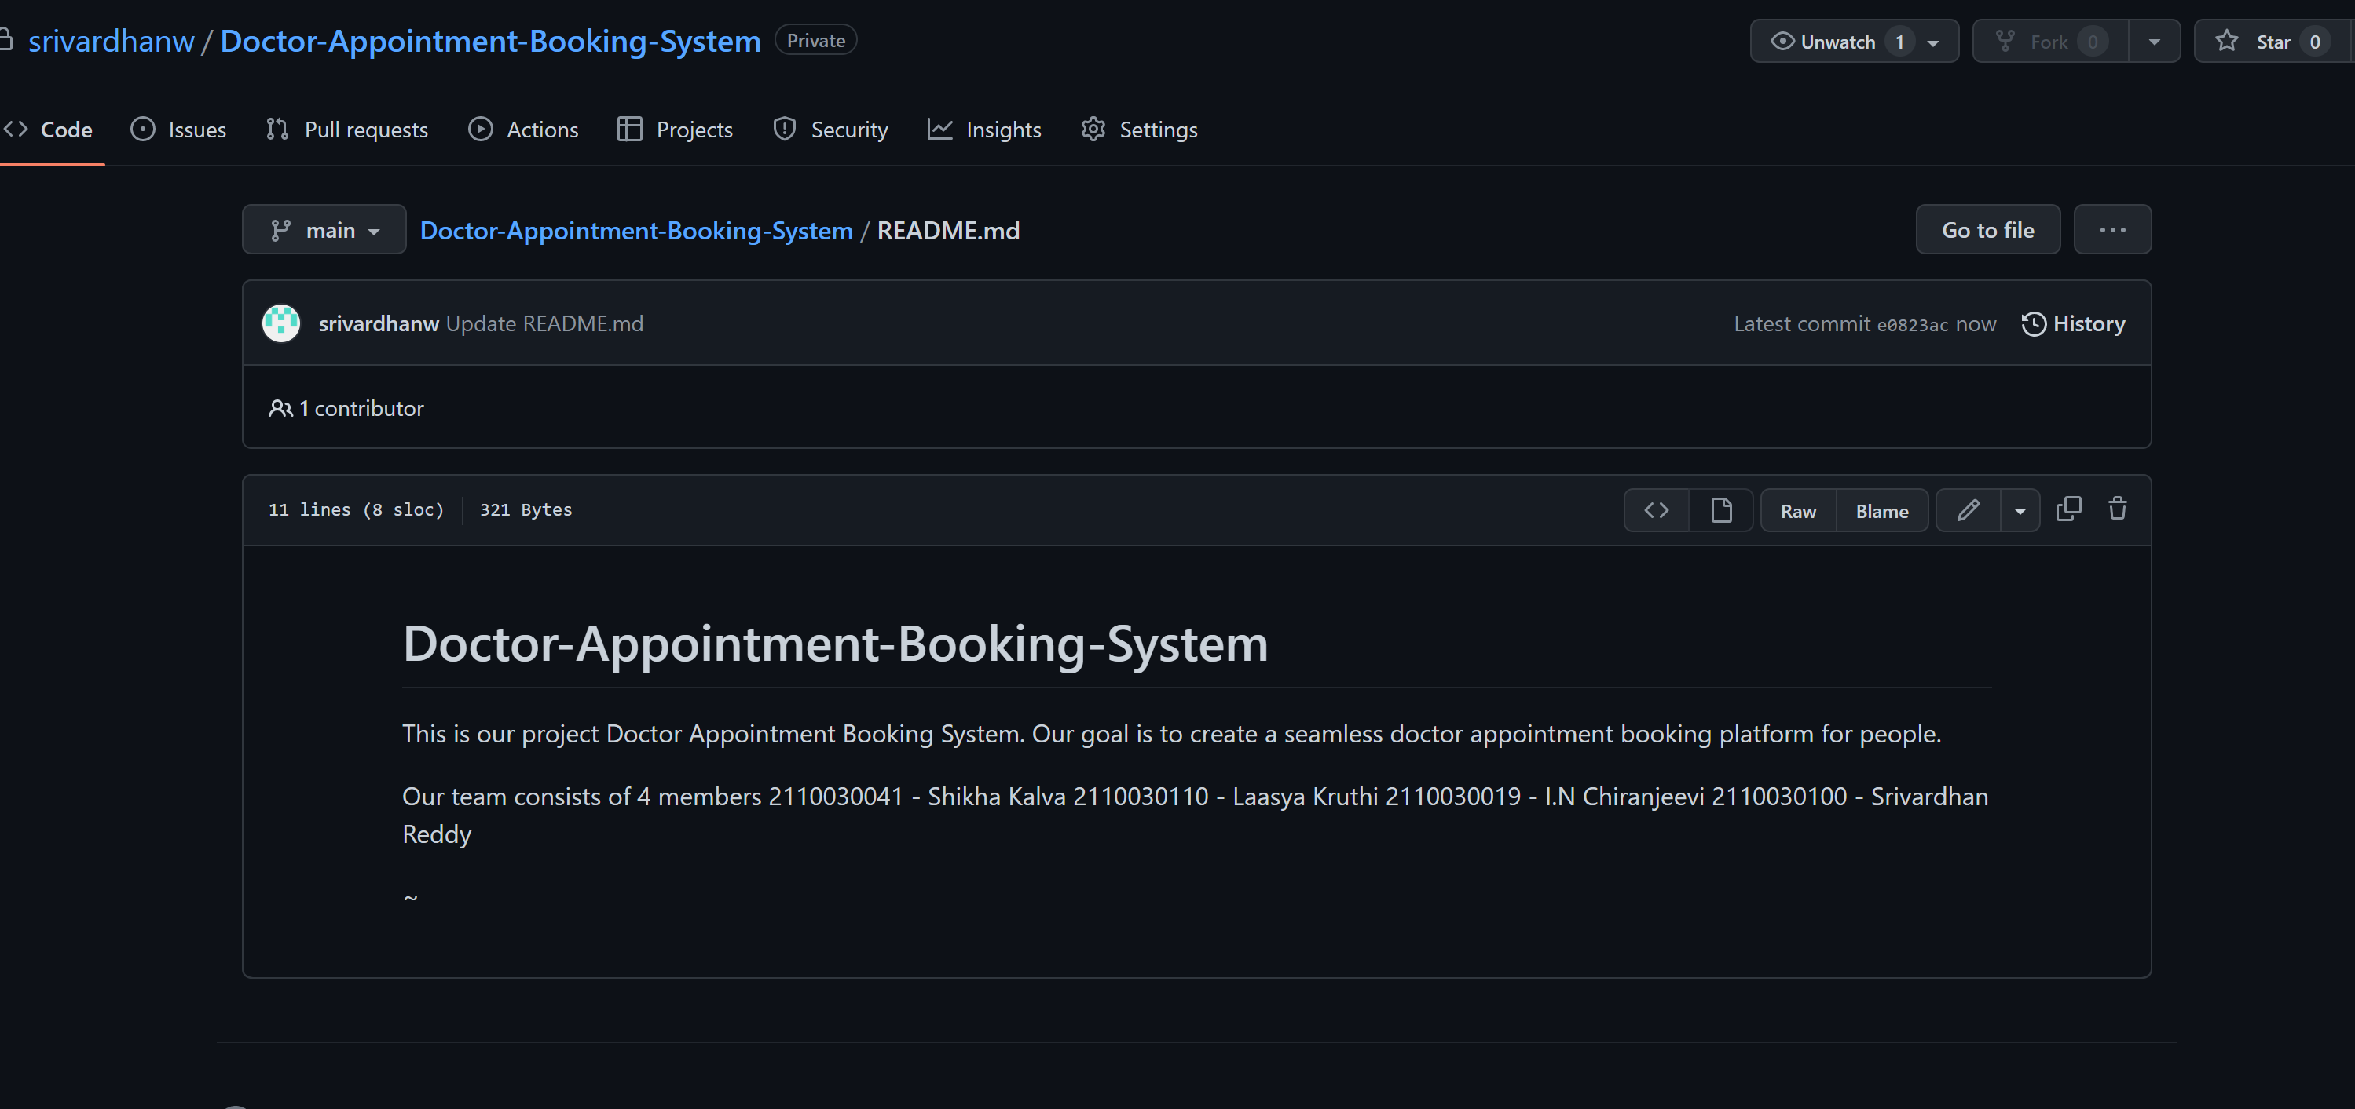

GITHUB SETUP
https://github.com/srivardhanw/Doctor-Appointment-Booking-System
By clicking the given link, it will direct you the project repository where you can find the source code and all the information about our project : doctor appointment booking system

Slide 7

Benefits
Reducing Patient Wait Times
Simplifying the Process of Finding a Doctor
Increasing Patient Satisfaction
24*7 booking: Anytime Anywhere
Multiple locations and multiple doctors

Slide 8
Work Allocation By The TEAM Members
We’ve divided our project into four parts:
Front-End – everyone from the team
Back-End – 2110030100_Srivardhan, 210030110_Laasya
Presentation & Class Diagram – 2110030019_Chiranjeevi, 2110030041_KalvaShikha
Data Set Management - 210030110_Laasya, 2110030041_KalvaShikha

Slide 9

Data set collection
A data set is a structured collection of data points related to a particular subject. A collection of related data sets is called as a database.
Items of related data are:
Patient Details
Contact No.
Name
Gender
Age
2. Doctor Details
Contact No.
Name
Specialization

Slide 10



Tool setup
Python
MySQL
Kivy
Heroku
Pycharm

Slide 11
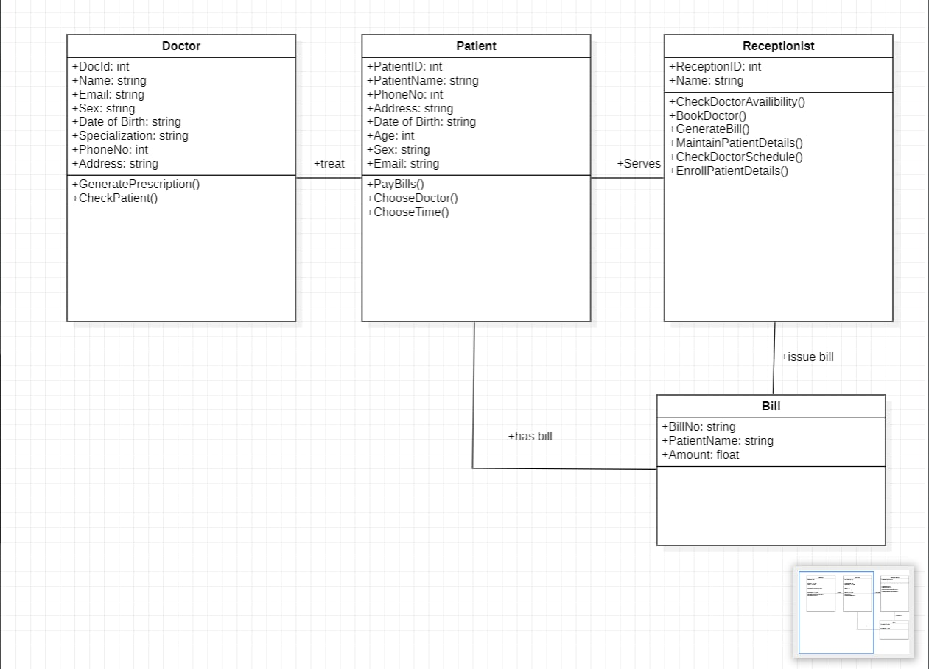
Class diagrams

Slide 12
THANK YOU <3

